Slide 1

RUNGTA COLLEGE OF DENTAL SCIENCES & RESEARCH
TITLE OF THE TOPIC:IRRIGANTS AND IRRIGATION
DEPARTMENT OF CONSERVATIVE DENTISTRY AND ENDODONTICS

Slide 2
Specific learning Objectives
At the end of this presentation the learner is expected to know ;
Core areas* | Domain ** | Category #
ANATOMY OF PERIAPEX CEMENTUM PERIODOTAL LIGAMENT INGLES CLASSIFICATION ZONES OF FISH | COGNITIVE | MUST KNOW
PATHWAY OF ENTRY OF MICROORGANISMS IN TOOTH | PSYCHOMOTOR | NICE TO KNOW
DIAGNOSIS OF PERIAPICAL TISSUE ENDO PERIO LESSIONS | AFFECTIVE | DESIRE TO KNOW

Slide 3
Contents
Introduction
Ideal properties of irrigating solutions
Goals of irrigation
Classification of irrigating solutions
Individual irrigants
Sodium hypochlorite(naocl)
Hydrogen peroxide (3% h₂o₂)
Iodine compounds
Chlorhexidine gluconate
Organic acids
-Edta
-Citric acid

Slide 4
Ruddle’s solution
Urea
Physiologic saline solution
Mtad
ozone
Combination of irrigants
Selection of irrigants
Methods of irrigation
Various delivery systems for irrigation
Complications during irrigation

Slide 5
Selection of irrigants
New modalities of irrigation
Summary
Conclusion
References

Slide 6
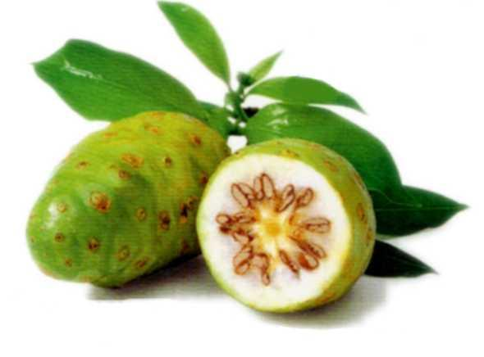
3. MORINDA CITRIFOLIA

Slide 7
Morinda citrifolia
Morinda citrifolia (MCJ) has a broad range of therapeutic effects, including antibacterial, antiviral, antifungal, antitumor, antihelminthic, analgesic, hypotensive, anti-inflammatory, and immune-enhancing effects.
MCJ contains the antibacterial compounds L-asperuloside and alizarin.

Slide 8
Murray et al. proved that, as an intracanal irrigant to remove the smear layer, the efficacy of 6% MJC was similar to that of 6% NaOCl in conjunction with EDTA.
The use of MCJ as an irrigant might be advantageous because it is a biocompatible antioxidant and not likely to cause severe injuries to patients as might occur through NaOCl accidents.
Root canal irrigants J Conserv Dent. 2010 Oct-Dec; 13(4): 256–264.

Slide 9
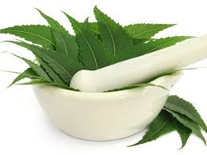
4. Azadirachta indica

Slide 10
Azadirachta indica, commonly known as Neem, is an evergreen tree, cultivated in several parts of the Indian subcontinent.
Every part of the tree is used as traditional medicine for the household remedy against various human ailments, from the ancient period.
Neem has been proved to be effective against E. faecalis and C. albicans. Its antioxidant and antimicrobial properties makes it a potential agent for root canal irrigation as an alternative to sodium hypochlorite.

Slide 11

NaOCl
H₂O₂
1.
Grossman introduced the use of Hydrogen peroxide alternated with the solution of NaOCl.
Marshall et al(1960) reported that the combination significantly increases dentin tubule permeability.

Slide 12
Effervescent reaction, in which it mechanically bubbles and pushes debris out of canal through least resistant orifice into chamber.
Effervescence was noted when NaOCl followed the use H₂O₂ .
Notes:
no bubbling occurred when H₂O₂ followed NaOCl

Slide 13
Advantages of combination
NaOCl has solvent action on organic debris of pulp tissue.
Disinfecting action of both solutions.
Nascent O₂ destroys some strict anaerobes thus allowing deeper penetration of NaOCl.
Bleaching action of both solution.

Slide 14
Disadvantage of combination
Reduction in tissue dissolving property of NaOCl.
using equal amount of 3% H₂O₂ and 5.25% NaOCl inhibits antibacterial action of irrigants.
Irritation of the periapical region.
Harrison

Slide 15
_{NaOCl}
_{CHX}
2.
An additive antimicrobial action.
A tissue dissolving property that is better than that obtained with use of CHX alone.
A solution less toxic than NaOCl.
Notes:
It is seen that when a combination of 2.5% NaOCl and 0.2 % CHX are used in root canal the advantages that could be gained are

Slide 16
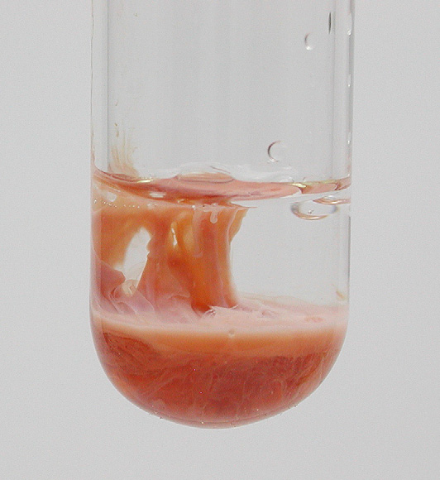
Baumgartner et al studied their interaction and found the formation of a precipitate.
by the acid– base reaction that occurs when NaOCl and CHX are mixed.
This proton exchange results in the formation of a neutral and insoluble substance precipitate.
Notes:
CHX, a dicationic acid (pH 5.5– 6.0) has the ability to donate protons.
NaOCl is alkaline and can accept protons from the dicationic CHX

Slide 17
Immediate reaction occurs when 2.0% CHX was combined with NaOCl, even at the low concentration
As the concentration increased , the color darkened and the precipitate thickened.
Baumgartner et al
Notes:
(0.023%)

Slide 18
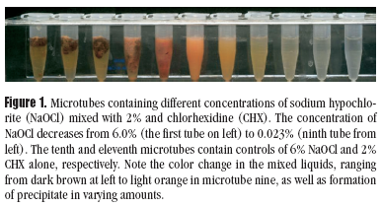

Slide 19
The precipitate, para-chloroaniline (PCA) has been shown to be toxic .
It is an aromatic amine, with the primary toxic effect is methemogloblin formation .
Notes:
NaOCl/CHX precipitate tends to occlude the dentinal tubules.

Slide 20
Short-term exposure of humans to PCA results in cyanosis, which is a manifestation of methemoglobin formation.
NaOCl/CHX precipitate tends to occlude the dentinal tubules.

Slide 21
EDTA
CHX
3.
CHX is not degraded by EDTA under normal conditions. The precipitate is most likely a salt formed by electrostatic neutralization of cationic CHX by anionic EDTA. The suspected net ionic equation is:
2HEDTA3- (aq) + 3H2CHX2+ (aq) ↔ (HEDTA)2(H2CHX)3(S)

Slide 22
CHX + EDTA produces a white precipitate.
The clinical significance of this precipitate is largely unknown. It seems that the ability of EDTA to remove the smear layer is reduced.

Slide 23
CHX
HYDROGEN PEROXIDE
4.
When used in combination, they were more effective than CHX alone.
The action of hydrogen peroxide on smear layer could allow penetration of CHX into the dentinal tubules.

Slide 24
CHX kills most of the bacteria in the area adjacent to the lumen while at the deeper layers it has diminished effect.
Hydrogen peroxide can penetrate more easily and affect bacteria in deep layers of the lumen.

Slide 25
This combination is effective against – Gram positive and Gram negative organisms, Fungi, Facultative anaerobes & aerobes.

Slide 26
EDTA
_{NaOCl}
5.
Bystrom & Sundquis found that the combined use of EDTA & NaOCl solution was more effective than NaOCl alone.
NaOCl dissolves and aids in the removal of the organic component and EDTA aids in the removal of the inorganic calcific component of the smear layer.

Slide 27
But both citric acid and EDTA immediately reduce the available chlorine in solution, rendering the sodium hypochlorite irrigant ineffective on bacteria and necrotic tissue .
The “bubbling effect” or effervescence is only proof of the chemical reaction that takes place between hypochlorite on the one hand and EDTA on the other hand, resulting in evaporating gas due to release of chlorine ion.
Zehnder et al
Baumgartner et al

Slide 28
MTAD
_{NaOCl}
6.
MTAD is an effective solution for the removal of the smear layer when used as a final rinse.
It does not significantly change the structure of the dentinal tubules when used in conjunction with NaOCl as a root canal irrigant.
Torabinejad et al

Slide 29
Reduction in antimicrobial substantivity of MTAD after initial NaOCl irrigation.
NaOCl causes oxidation of MTAD.
Pashley et al

Slide 30
MTAD as irrigant before the use of NaOCl results in formation of brown solution which is caused by the dentinal absorption & release of doxycycline present in MTAD solution.
MTAD is always final rinse.
Torabinejad et al

Slide 31
CHX
_{MTAD}
7.
2% CHX and MTAD is mixed which led to formation of dark brown precipitates. These precipitates are formed due to reaction of chlorhexidine and citric acid present in the MTAD.

Slide 32
SELECTION OF IRRIGANTS

Slide 33
Different clinical situations warrant the use of different irrigants or their combinations .
The following are the recommendation for the same.

Slide 34
1. Vital pulp tissue
Sodium hypochlorite may be choice of irrigant.
Irrigation done with 2ml of sodium hypochlorite (5.25percent) and/or urea peroxide.
The tissue dissolving ability of this irrigant may help to remove the friable pulp tissue which is otherwise difficult to remove only with a barbed broach.
A second application and its activation is obtained by using a K file (#08-10).

Slide 35
This will disorganize the pulpal tissue in both the cervical and middle thirds of the endodontic system.
This step has to be preceded by an abundant irrigation with distilled water in order to eliminate the first mixture present in the access cavity.
The early use of EDTA facilitates the flow of the different irrigants in the lateral canals permitting a chemical preparation of all the endodontic system.

Slide 36
Chlorhexidine can be used for a total elimination of the bacteria inside the canal.
Distilled water is used between each irrigating solution in order to prevent an acid/ base reaction, between sodium hypochlorite and EDTA, for a more efficient action of the chemicals on the tissues.

Slide 37
2. Necrotic pulp
The main difference between vital teeth and necrotic ones is the absence, not in total, of the pulpal parenchyma and the abundance of bacteria present in the latter.
For this reason, the irrigation sequence will be different.
Irrigation will be initiated with either sodium hypochlorite (5.25%, 60s) for its anti-bacterial effect or with chlorhexidine (0.2%) (10 minutes) for the elimination of various bacterial types present in the root canals and dentinal tubules.

Slide 38
Distilled water is used to neutralize the effect of these irrigants.
Then the same irrigation sequence described previously for vital teeth is used.
The EDTA, by eliminating the smear layer and opening the dentinal tubule will permit an easy flow of NaOCl or chlorhexidine for a better disinfection of the endodontic system.
Anaerobic bacteria are present in the necrotic pulp. So a combination of NaOCl and H₂O₂ which gives rise to nascent oxygen and foaming can also be used

Slide 39
3. Irrigant used in treating acute abscess
At the emergency appointment, the preferred irrigant in the initial stages of including drainage should be warm water or saline.
NaOCl clumps exudates which might cause plugging of apical constriction and halt drainage.

Slide 40
When patency through apex is maintained, NaOCl may be used if canal is to be prepared further at the emergency appointment.
In another appointment, if it is necessary to close a case without canal preparation, H₂O₂ can be used to bubble out debris with a final irrigation with chlorhexidine.

Slide 41
Open foramina
NaOCl is irritant to periapical tissue.
Chlorhexidine is better as they cause low peripical irritation.

Slide 42
Calcified canals
Chelating agents may be useful in the location of difficult-to-find orifices by sealing in chamber between appointments.
Because the orifices are less calcified than the surrounding dentin, sufficient softening may allow it to be located with the sharp tip of Endodontic explorer at the next appointment.

Slide 43
Lateral canals
When 2.6 to 5.25% of NaOCl is used in conjunction with ultrasonically energized instrument, cleanest root canals, cul-de-sacs, isthmus and lateral canals will result.

Slide 44
Persistent bleeding
Persistent bleeding after the gross removal of pulp tissue might be because of shreds of tissues in the inaccessible recesses.
A combination of 0.5% sodium hypochlorite and 3% hydrogen peroxide would be helpful.

Slide 45
TAKE HOME MESSEGE
Some of the problems that dentists face in their clinical practice are caused or facilitated by improper treatment of the root canal system.
In an attempt to accomplish the major goals of root canal treatment, namely to prevent and/or to control endodontic infections, clinicians use procedures, substances and materials that may induce some degree of injury to the periradicular tissues.
Invariably, periradicular tissue healing will occur uneventfully in cases where microorganisms were successfully eliminated from and/or prevented from gaining entry into the root canal system and minimal or no damage was inflicted on the periradicular tissues during therapy.
The worst-case scenario for periradicular tissue response to intra-canal procedures is reflected largely in post-operative pain and persistence of periradicular disease despite treatment. While the development of post-operative pain is largely a short-term response related to the extent of tissue injury, post-treatment disease is a long-term response influenced by the persistence of the source of injury.
Even though chemical and mechanical factors can be involved with unfavorable responses of the periradicular tissues to intracanal procedures, microorganisms are the major causative agents of post-operative pain and posttreatment disease.

Slide 46
Questions
1. Criteria for selection of irrigants.
2. Advantages of combination of irrigants used.
3. Write advantages of combination of NaOCl and H2O2 combination as
irrigant.

Slide 47
References
Operative Dentistry – MA Marzouk
Art & science of operative Dentistry – Sturdevants (5th edition)
Art & Science of Operative Dentistry – Sturdevants (South Asian Edition)
Textbook Of Operative Dentistry – Vimal K Sikri (1st Edition)
Dental Anatomy, Physiology & Occlusion – Wheeler’s (9th Edition)
Optimizing tooth form with direct posterior composite restorations JCD Oct-Dec 2011 | Vol 14 | Issue 4

Slide 48
THANK YOU

